Slide 1

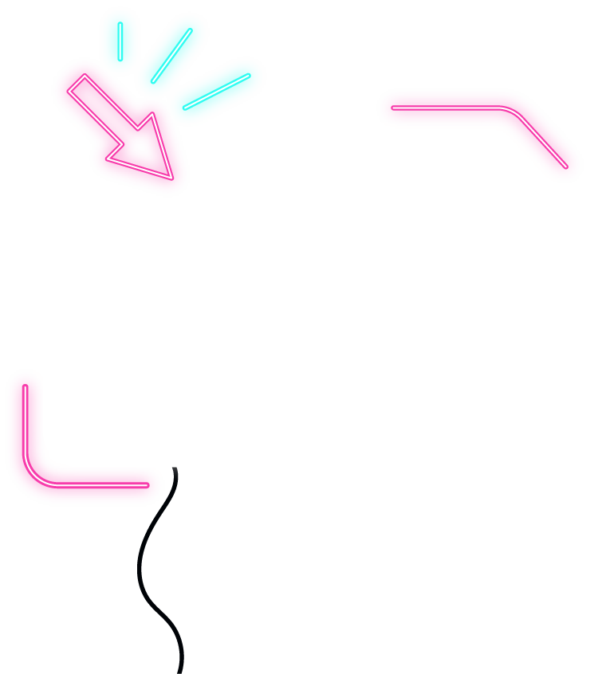


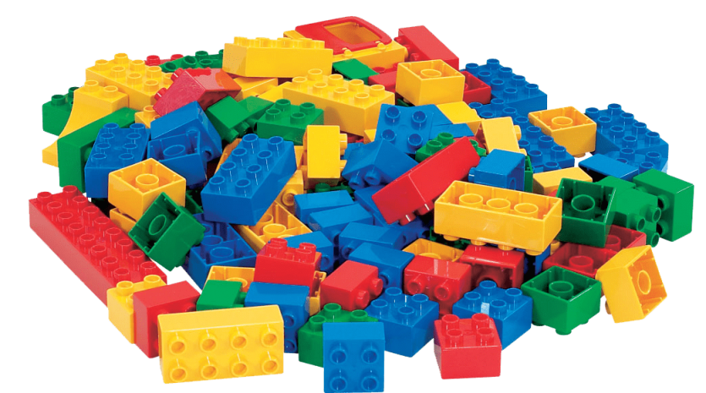

Project 3 A Classification Problem
By Randy Neo

Slide 2
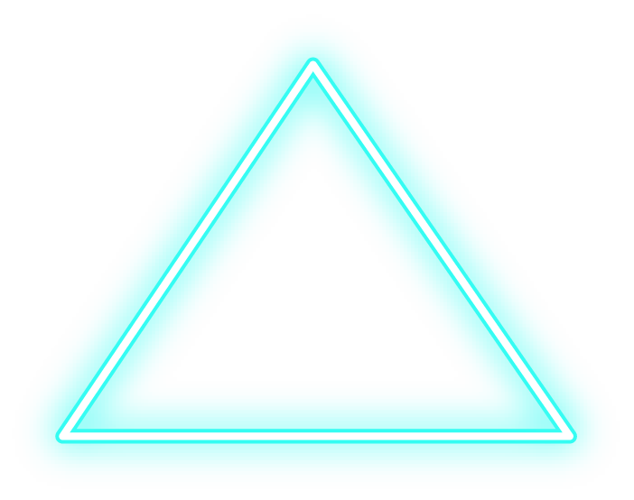




About the Project
Using Reddit's API, we’re to collect posts from two subreddits
We'll then use NLP to train a classifier on which subreddit a given post came from.

Slide 3


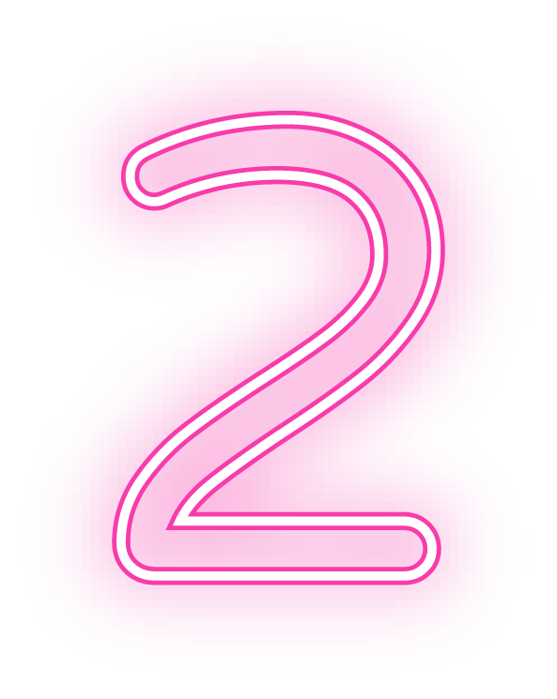
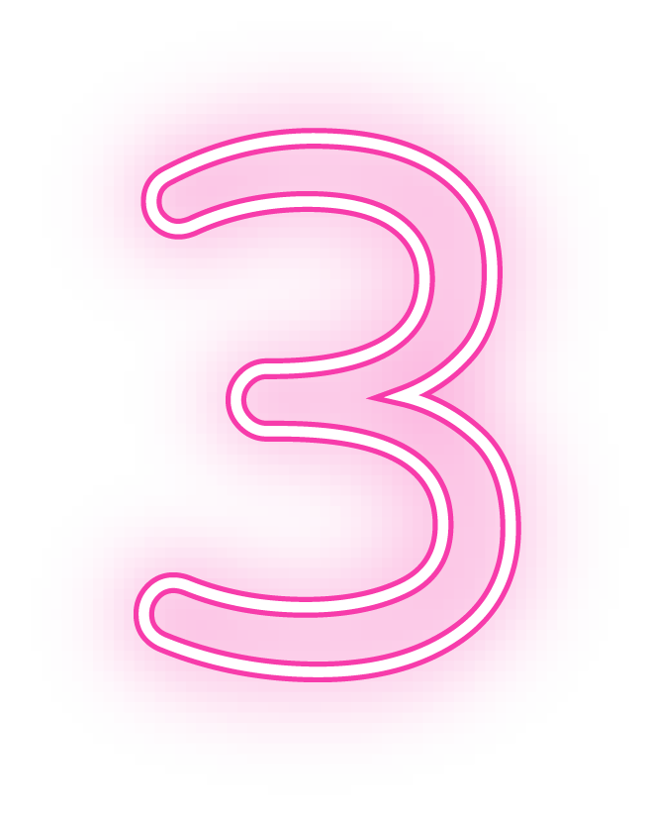

FIRST SECTION
SECOND SECTION
TABLE OF CONTENTS
THIRD SECTION
FOURTH SECTION
Defining the problem
Data Gathering + Data Exploration + Data Preparation
Modelling + Model Evaluation
Conclusion

Slide 4
Defining the Problem
Will classification model work effectively when given 2 very similar topics and which classifier to use?

Slide 5
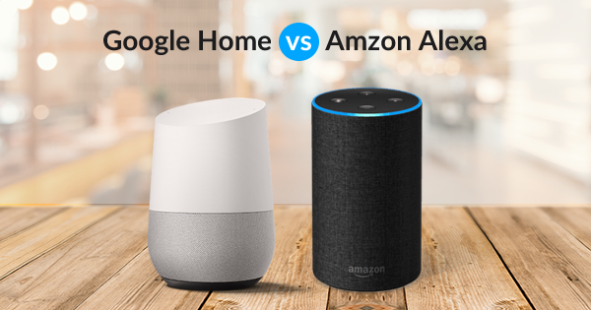
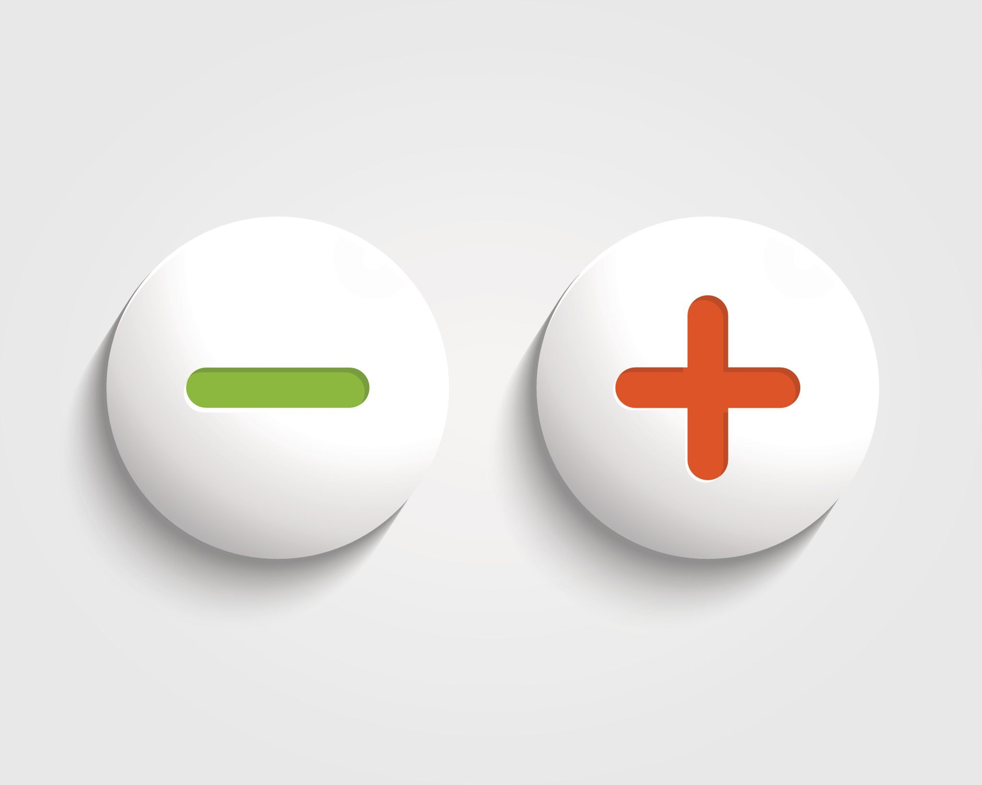
Google Home
Amazon Echo
Google Home and Amazon Echo were chosen for this project.
Both the Amazon Echo and the Google Home come with a host of features that allow you to both control the smart home and listen to the entertainment you like. Both devices allow you to give voice commands that will let you turn the thermostat up or down, turn on the lights, lock a door, and much more.

Slide 6
Data Gathering + Exploration + Preparation
Using Reddit API, we extracted the data sets for each post

Slide 7
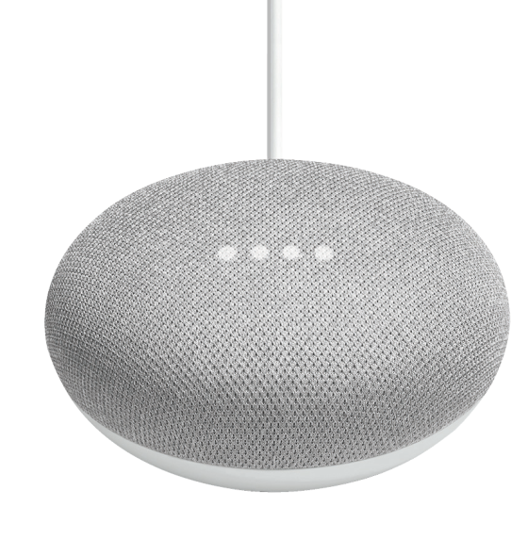
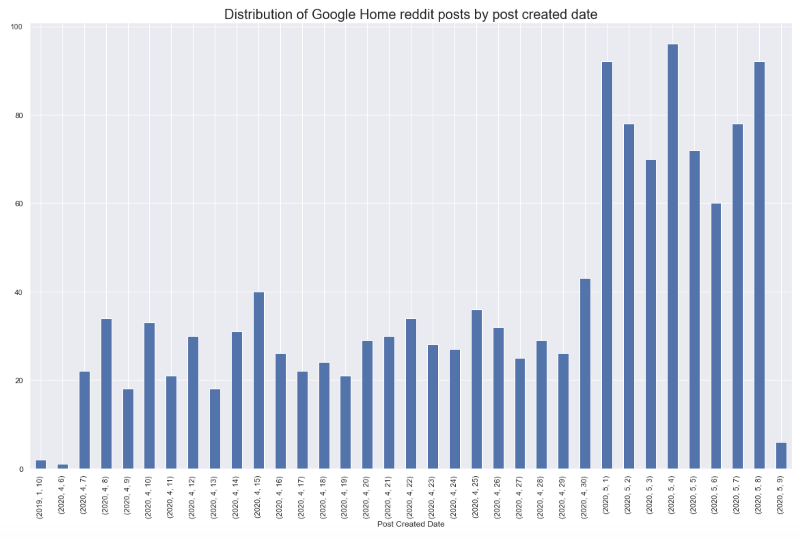
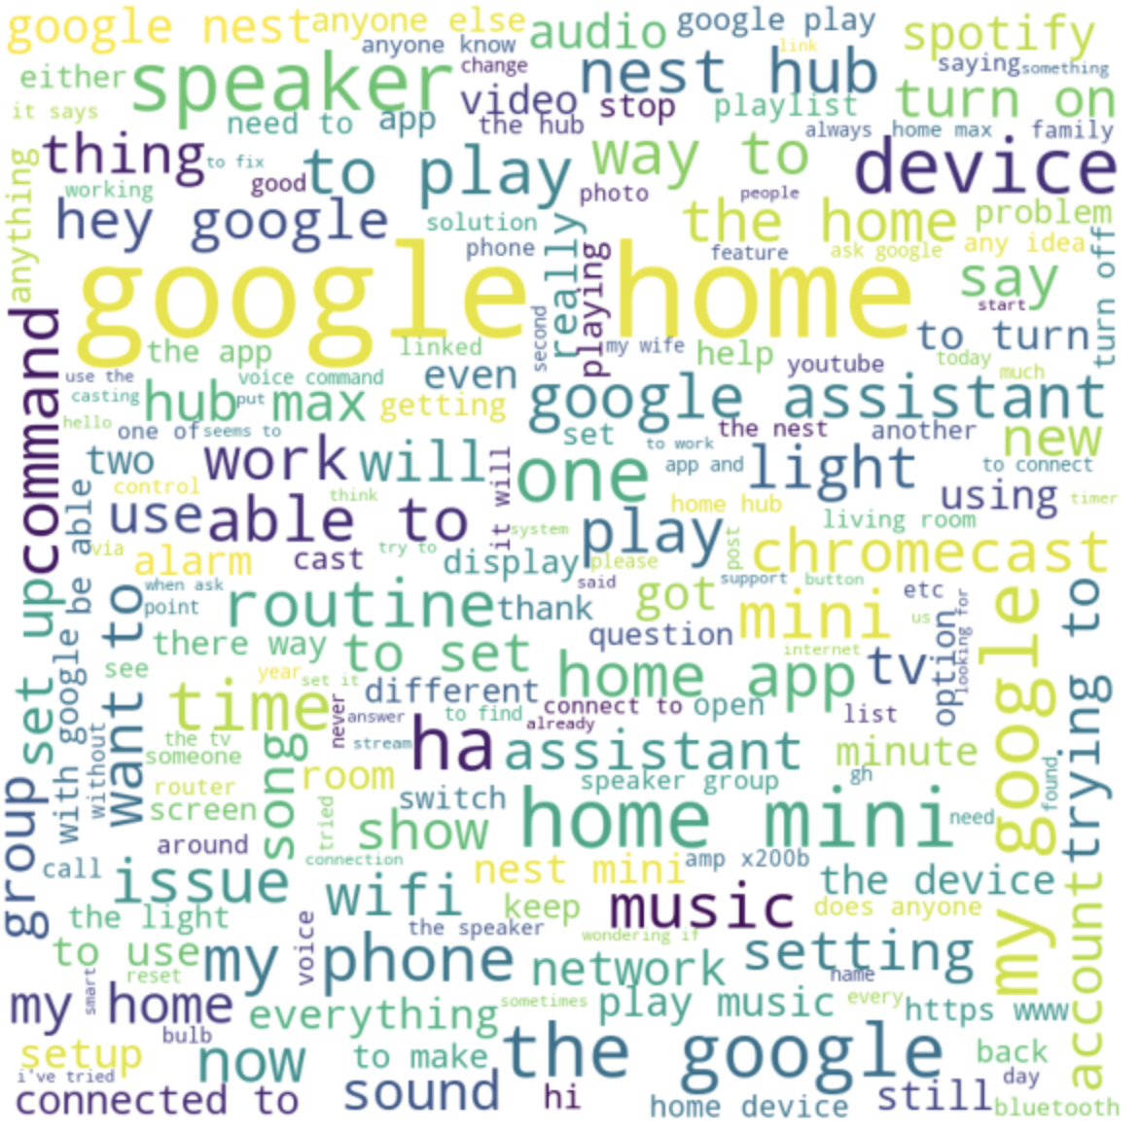
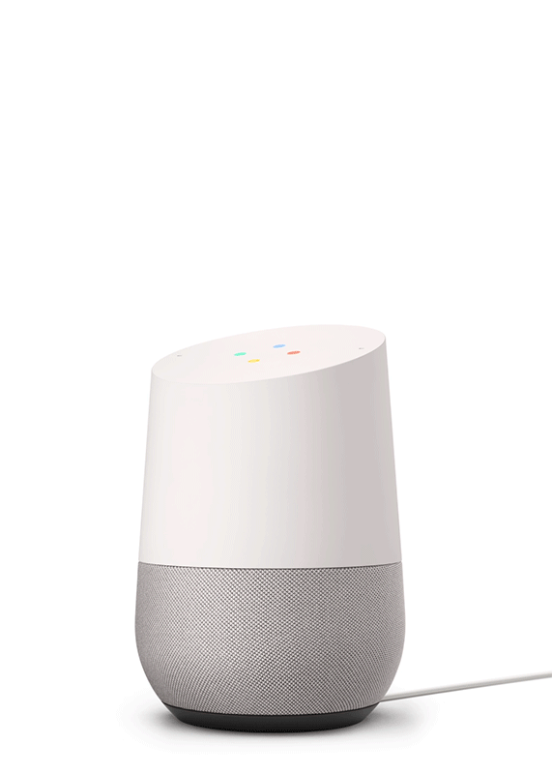
Perform EDA on Google Home
Distribution of posts by date
Word Cloud
Total of 998 unique posts were extracted Google Home subreddit gathered an average of 38 posts per period for the period gathered between (1 Jan 2019 - 9th May 2020)
Prominent words like google, home and mini will be added to the stop words when building our model

Slide 8
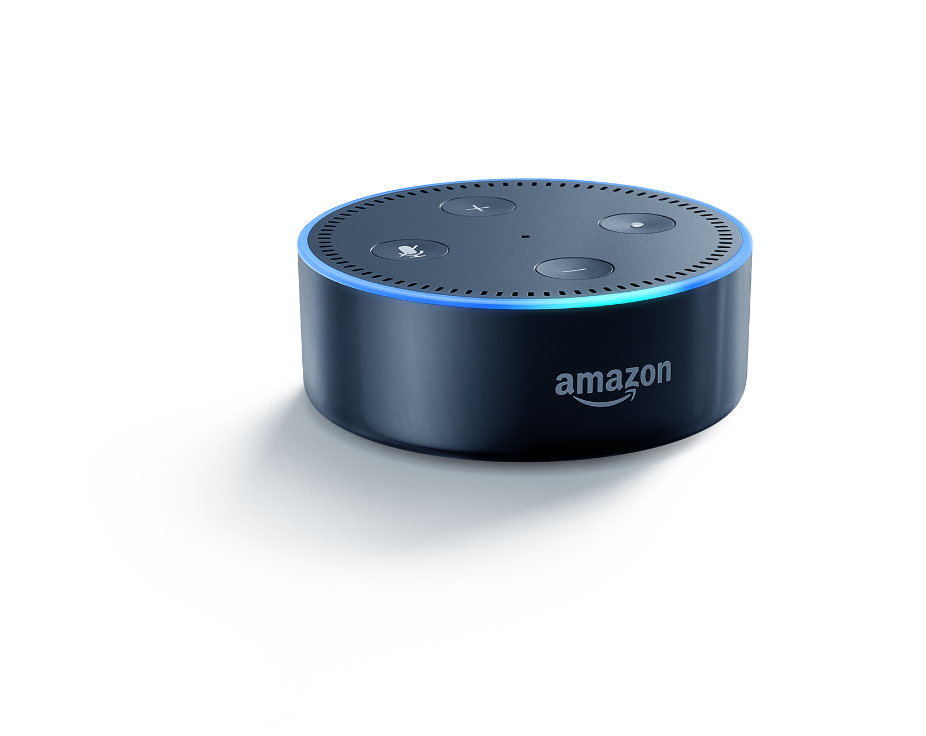
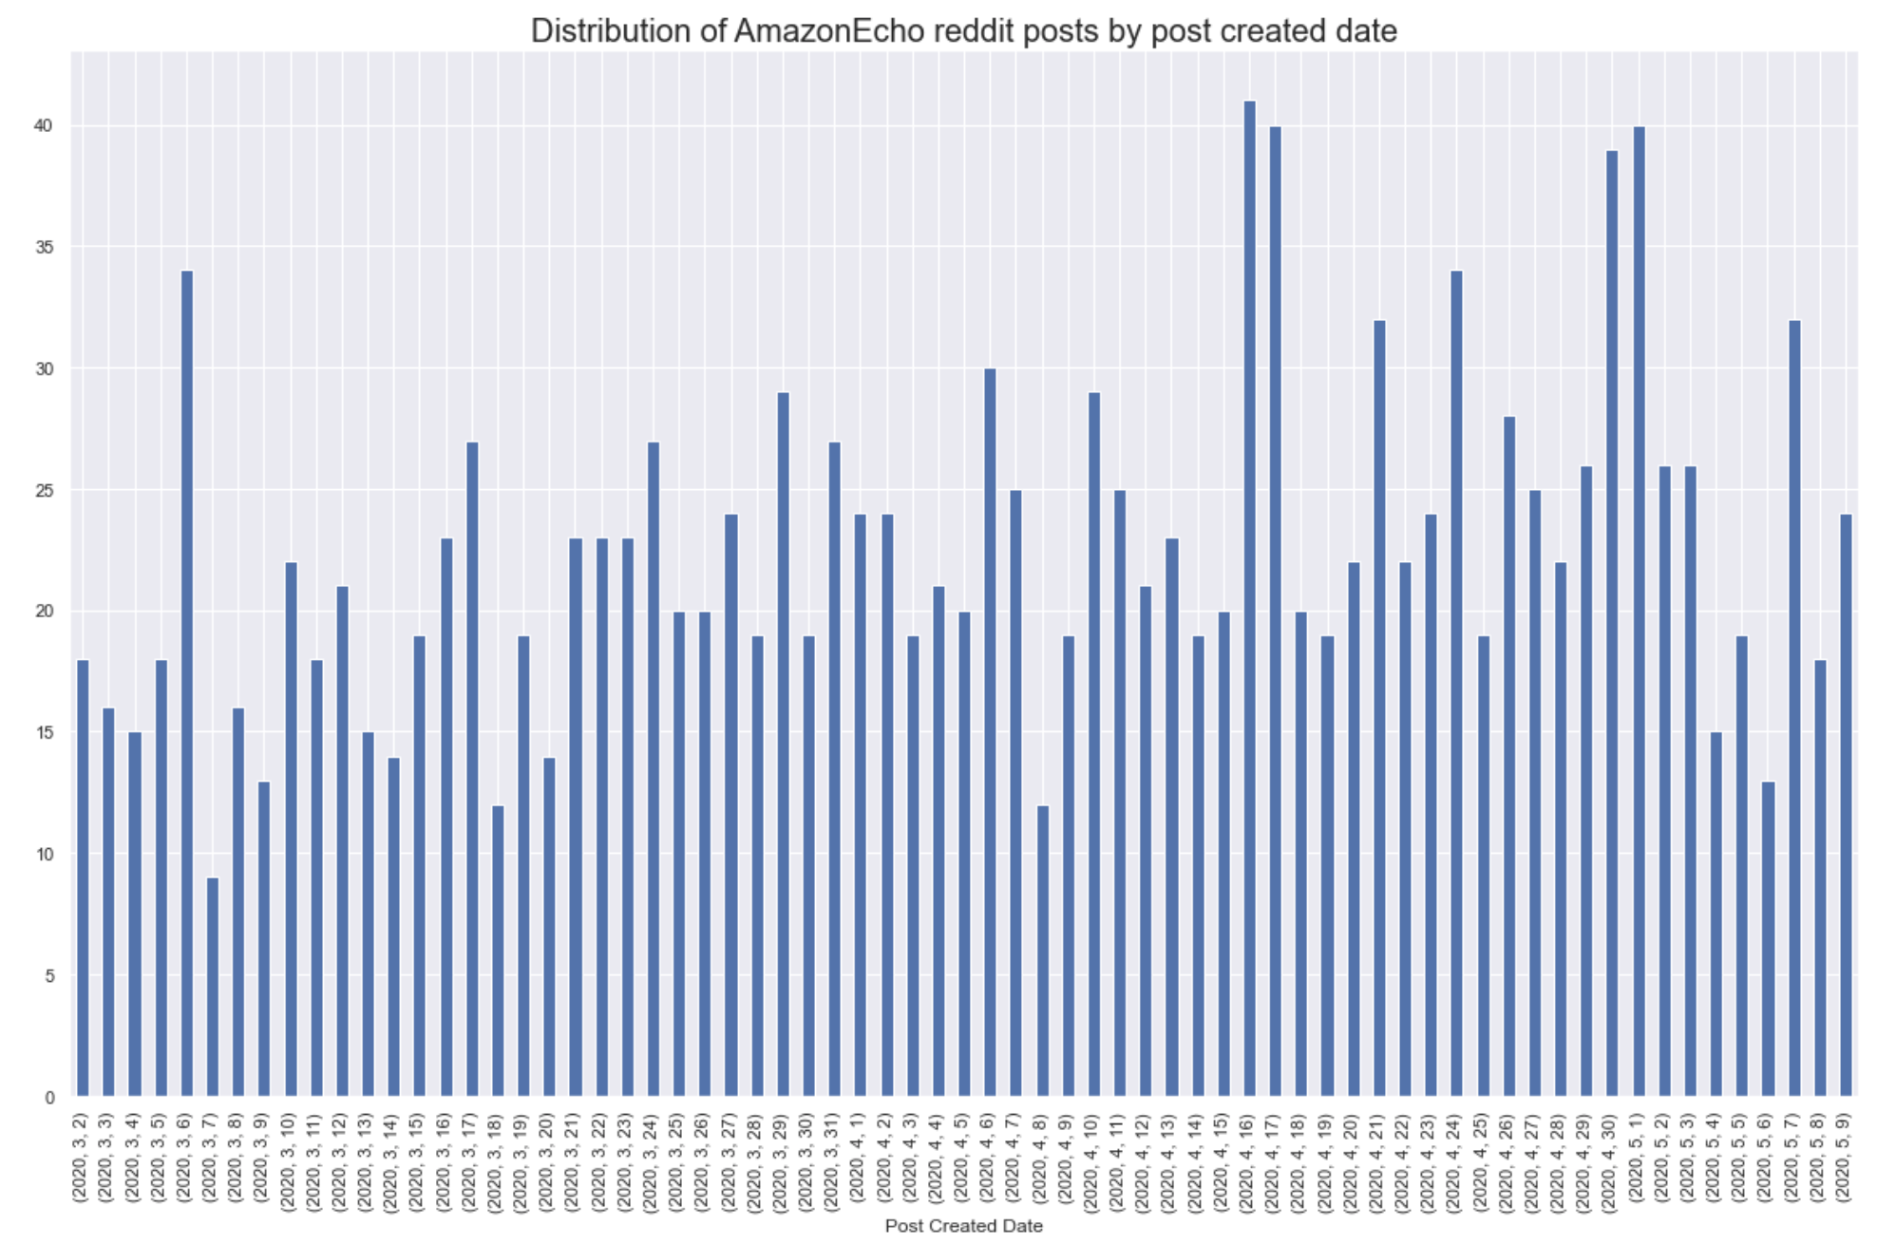
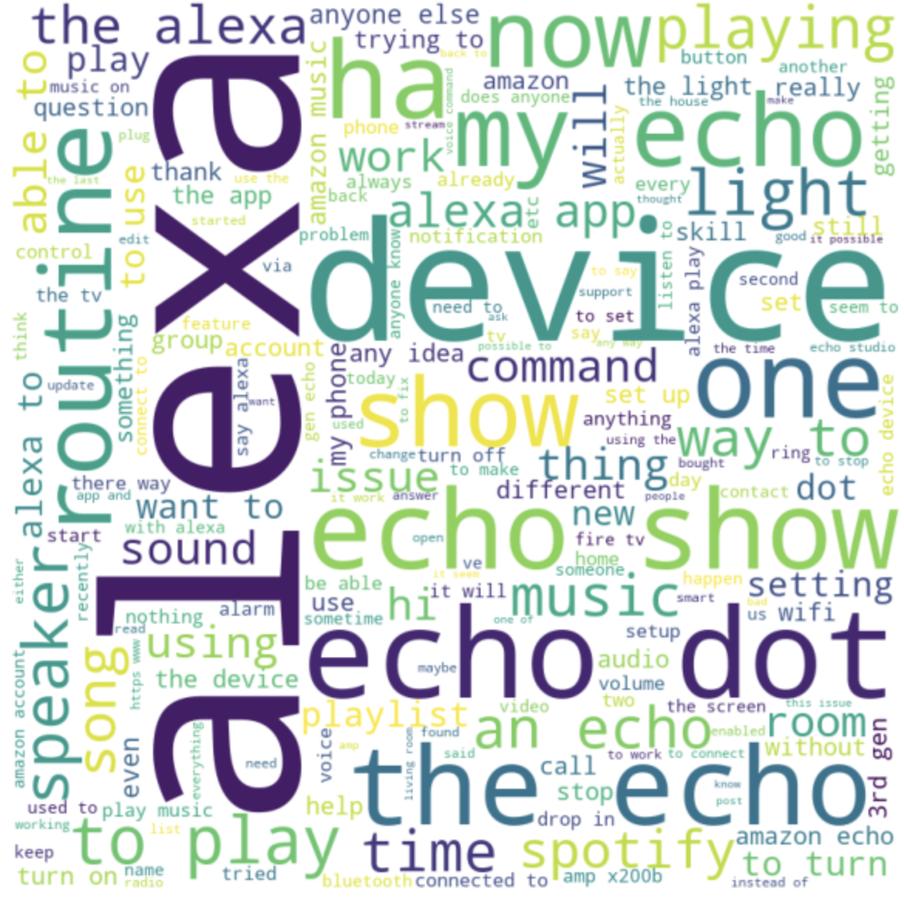
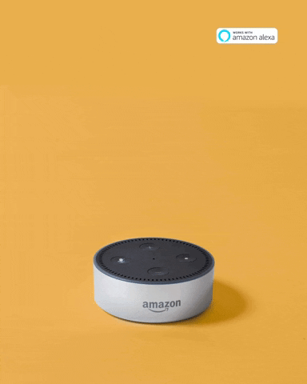
Perform EDA on Amazon Echo
Distribution of posts by date
Word Cloud
Total of 988 unique posts were extracted and the Amazon Echo subreddit gathered an average of 23 posts per period for the period gathered between (2nd Mar - 9th May 2020)
Prominent words like alexa, device, echo and dot will be added to the stop words when building our model

Slide 9

BeautifulSoup
Regex
NLTK StopWords
DATA CLEANING PROCESS
Stemming
Removal of HTML code artifacts
Removal of Non-Letters
Removal of stop words from the NLTK stopword list
(TF-IDF) Vectorizer
Stemming is a form of shortening words so we can combine similar forms of the same word
TF-IDF is a score that tells us which words are important to one document, relative to all other documents.

Slide 10
Modelling + Model Evaluation
Naïve Bayes Classifier vs Logistic Regression

Slide 11

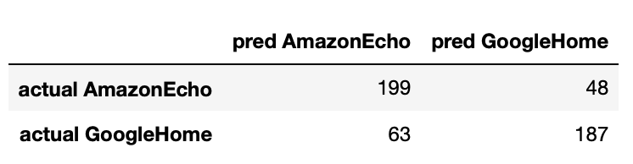
Naïve Bayes is a classification method based on Bayes’ theorem that derives the probability of the given feature vector being associated with a label. Naïve Bayes has a naive assumption of conditional independence for every feature.
With Tuning
Model Evaluation
Naïve Bayes Multinomial
Default Model
True Negatives: 199
False Positives: 48
False Negatives: 63
True Positives: 187
Training Score: 0.94425
Test Score: 0.77665
Training Score: 0.98517
Test Score: 0.881765
Accuracy : 0.77665
Sensitivity : 0.748
Specificity : 0.80566
Precision : 0.7957449

Slide 12
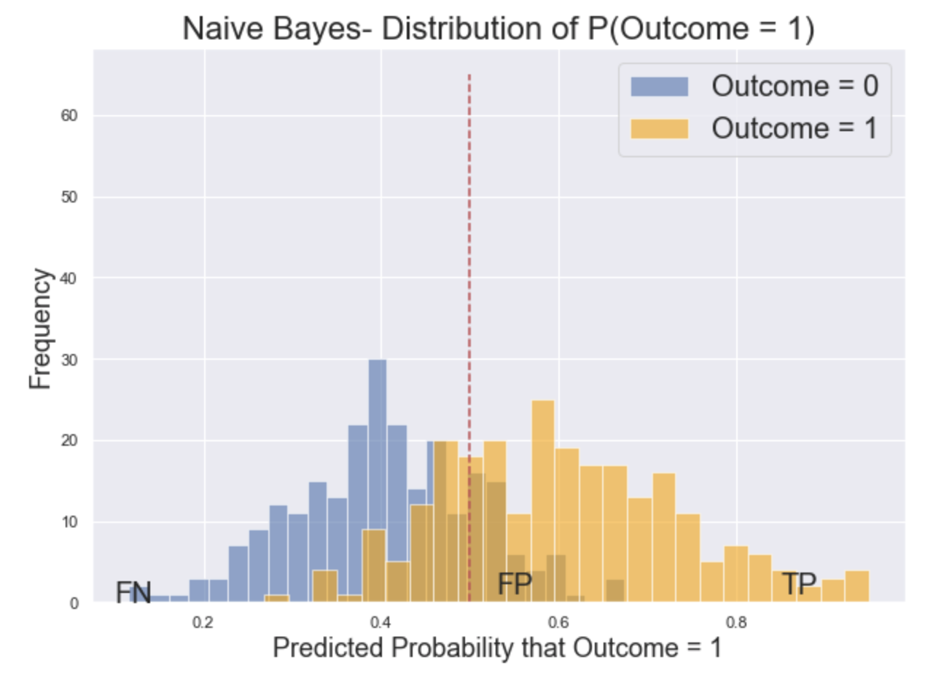
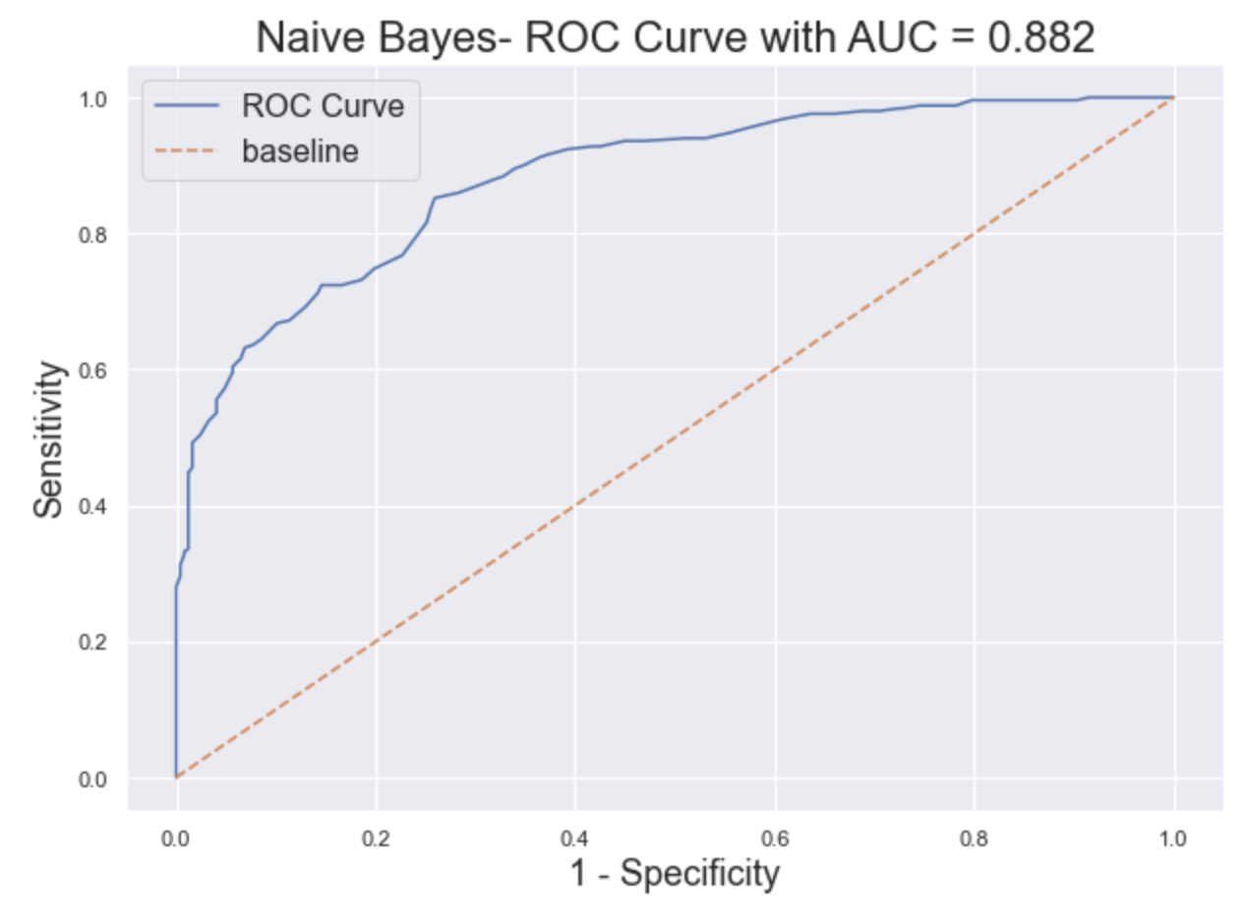
Naïve Bayes Multinomial
True Negatives: 199
False Positives: 48
False Negatives: 63
True Positives: 187
Accuracy : 0.77665
Sensitivity : 0.748
Specificity : 0.80566
Precision : 0.7957449
Notes:
The sensitivity of a test is also called the true positive rate (TPR) and is the proportion of samples that are genuinely positive that give a positive result using the test in question.
For example, a test that correctly identifies all positive samples in a panel is very sensitive. Another test that only detects 60 % of the positive samples in the panel would be deemed to have lower sensitivity as it is missing positives and giving higher a false negative rate (FNR).
The specificity of a test, also referred to as the true negative rate (TNR), is the proportion of samples that test negative using the test in question that are genuinely negative.
Another test that incorrectly identifies 30 % of healthy people as having the condition would be deemed to be less specific, having a higher false positive rate (FPR). Also referred to as type I errors,

Slide 13
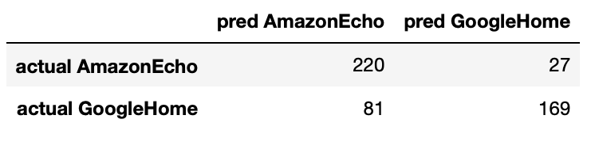
Logistic regression is a linear classification method that learns the probability of a sample belonging to a certain class. Logistic regression tries to find the optimal decision boundary that best separates the classes.
With Tuning
Model Evaluation
Logistic Regression
Default Model
True Negatives: 220
False Positives: 27
False Negatives: 81
True Positives: 169
Training Score: 0.95097
Test Score: 0.79879
Training Score: 0.99946
Test Score: 0.886186
Accuracy : 0.782696
Sensitivity : 0.676
Specificity : 0.89068
Precision : 0.862244

Slide 14
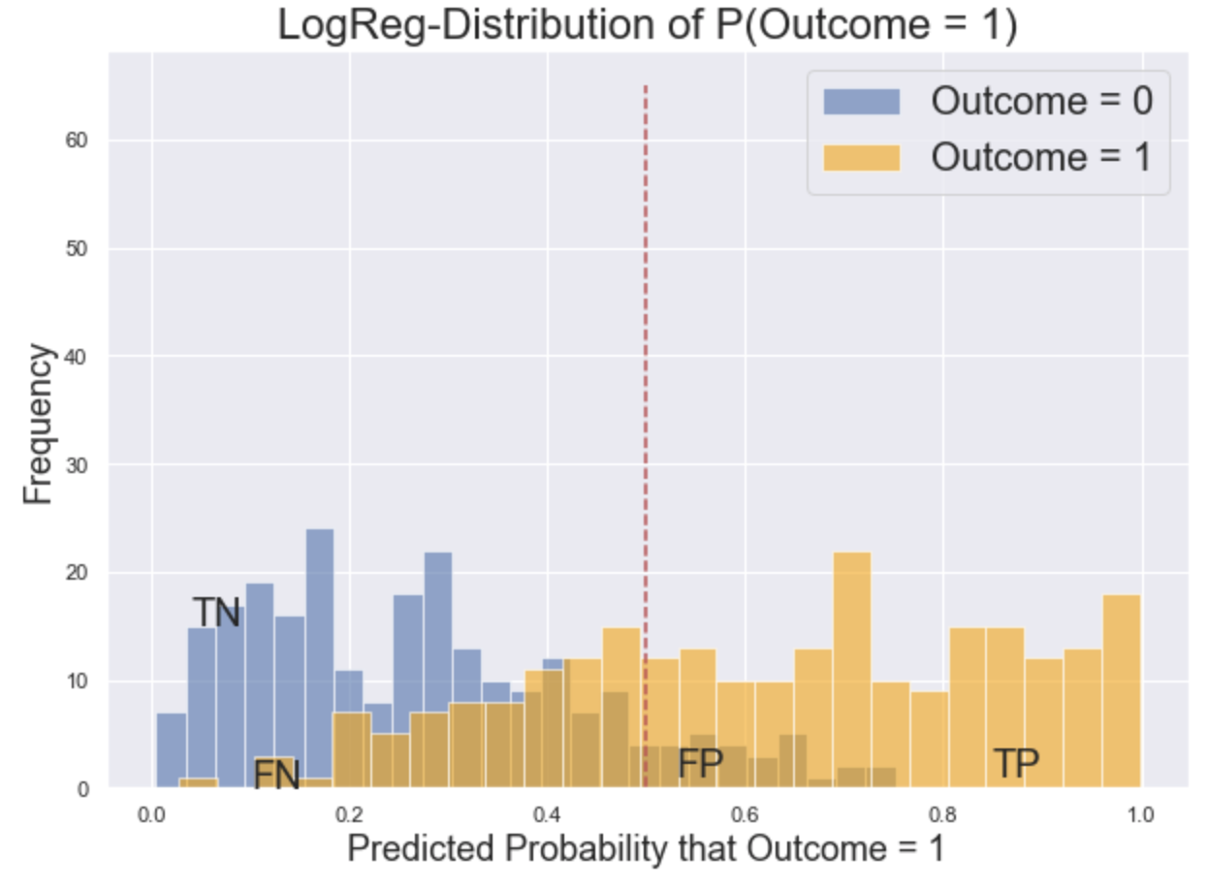
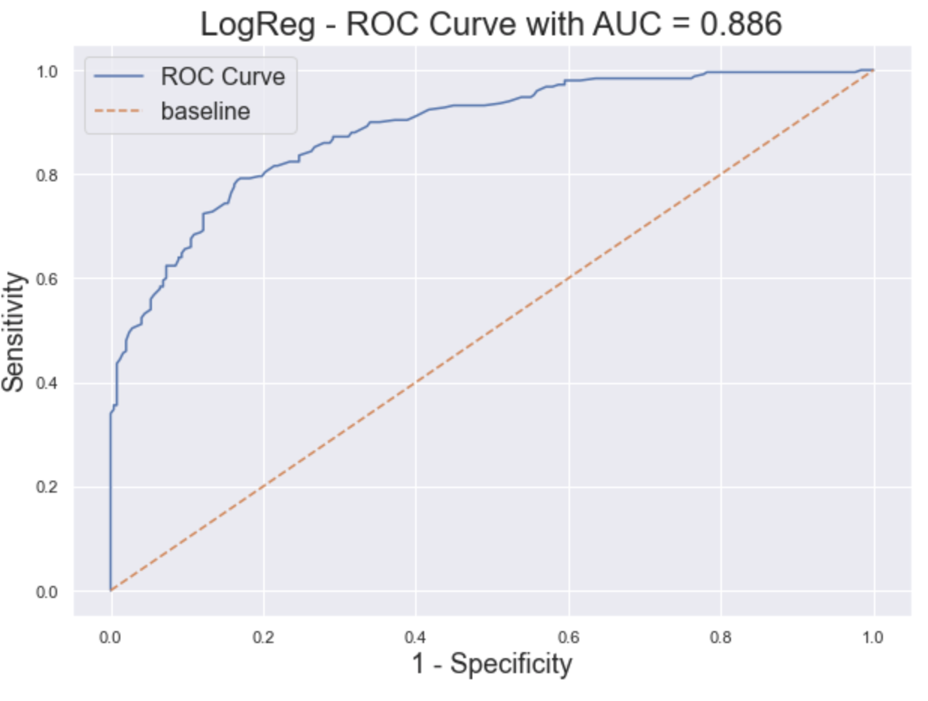
Logistic Regression
True Negatives: 220
False Positives: 27
False Negatives: 81
True Positives: 169
Accuracy : 0.782696
Sensitivity : 0.676
Specificity : 0.89068
Precision : 0.862244

Slide 15
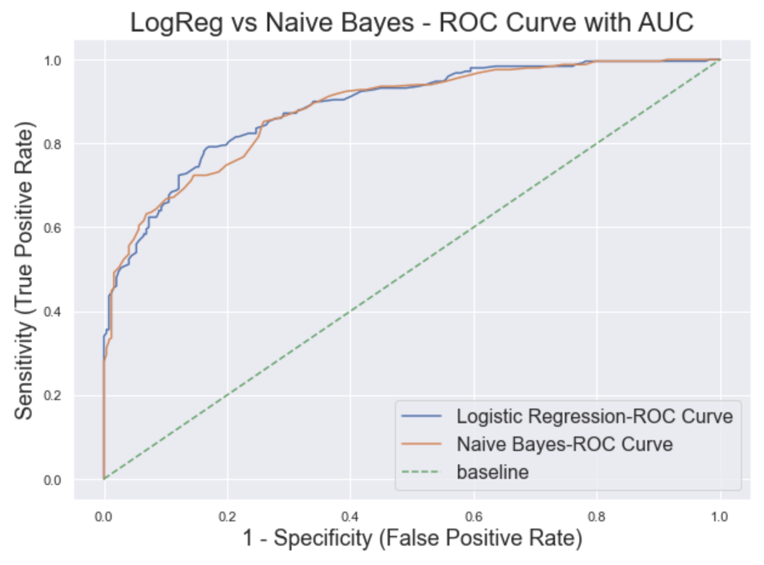
Model Evaluation
Both Logistic Regression and Naïve
Bayes’s AUC score are relatively close
(0.886 vs 0.882) , thus it depends on
which trade-off we want in our model
(high Precision/low Recall or low
Precision/high Recall. We have chosen
Logistic Regression which has higher
precision and lower Recall.
Logistic Regression has a higher
precision 0.86 (proportion of positive
results that were correctly classified)
as compared to Naive Bayes's 0.795.
Naive Bayes assumes that the features
are independent of each other.
However, this is not always possible as
real data sets are never perfectly
independent and they can be close.

Slide 16

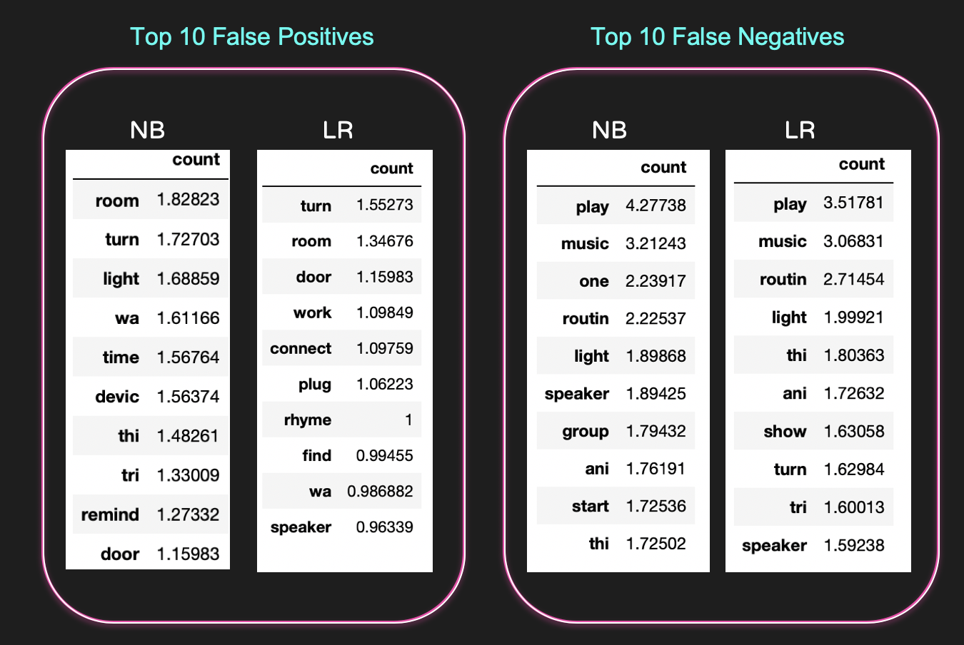
MISSCLASSED DATA
it seems these words that exists in both posts are common in smart devices.
eg. play, music, room, turn... And thus we may consider adding them to the stop words list
NB: Naïve Bayes LR: Logistic Regression

Slide 17
Conclusion

Slide 18

In this project, we are trying to build a model that is able to classify the GoogleHome post from the AmazonEcho post. Naive Bayes Classifier and Logistic Regression were used for this classification problem. We have chosen Logistic Regression as highlighted in model evaluation. From the review conducted for the misclassed features, we are of the view that because we are comparing between 2 smart devices, there will be overlapping words thus high positive/negatives. Despite that, we are still able to achieve a good accuracy score for our selected classifier model.

Slide 19

THANKS!
Please keep this slide for attribution.

